Slide 1


Good morning Accenture
Giving social Buzz the boost it needs

Slide 2


Today's agenda
Project recap
Problem
The Analytics team
Process
Insights
Summary

Slide 3

Accenture is assisting Social Buzz with its increasing business.
They are looking to complete an IPO by the end of next year and need guidance to ensure that this goes smoothly.
They need an audit of Social Buzz’s big data practices.
Analysis of Social Buzz’s most popular categories for content.
Project Recap

Slide 4


Problem
Social Buzz has over 100’000 posts per day
35’500’000 pieces of content per year
How can Social Buzz gain a competetive advantage with this data?

Slide 5



Andrew Fleming
-Chief Technical Architect
The Analytics team
Marcus Rompton
-Senior Principal Analyst
Paul Cunningham
-Data Analyst

Slide 6
Identify problems with Social Buzz with a brief (Data Understanding)
Process
1
Extract and clean datasets submitted by Social Buzz for analysis (Data Cleaning)
2
3
Compile the relevant information into one dataset (Data Modelling)
Identify patterns and trends that Social Buzz can use to gain a competitive advantage (Data Analysis)
4
5
Uncover Insights that Social Buzz can use to gain a competitive advantage

Slide 7
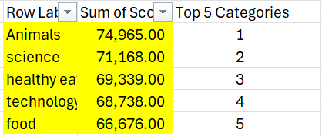

Insights

Slide 8

Summary

Slide 9

Thank you!
ANY QUESTIONS?

